Slide 1
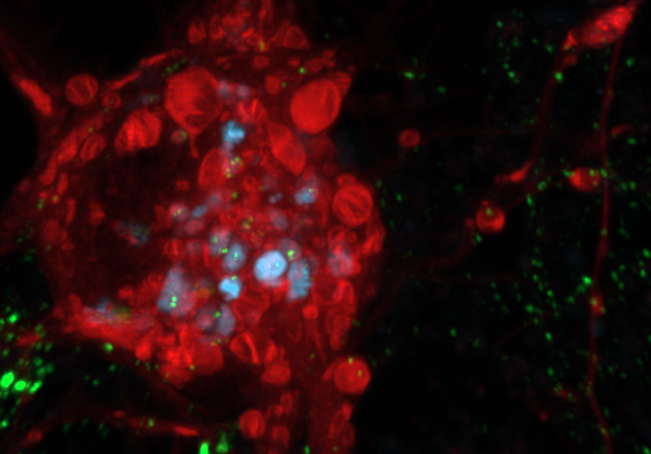
Autophagy, aging and neurodegeneration
Juliane Da Graça
14.10.2025
BioENG430

Slide 2
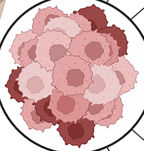
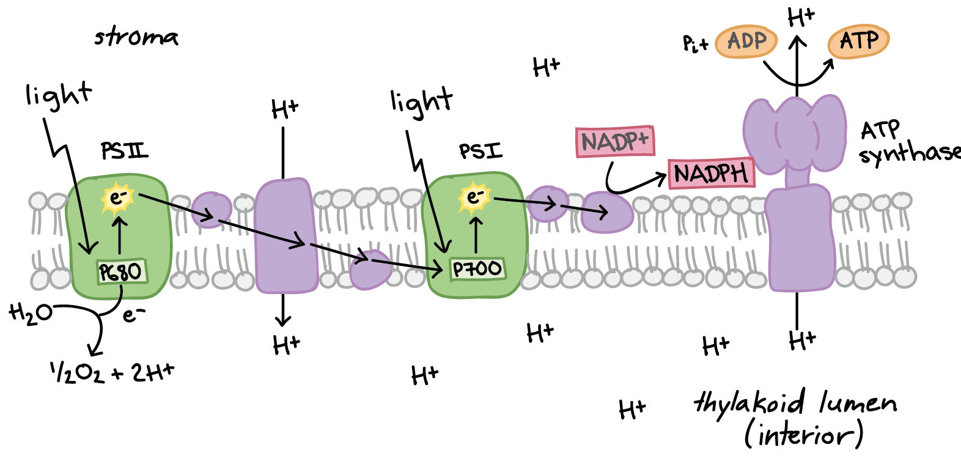
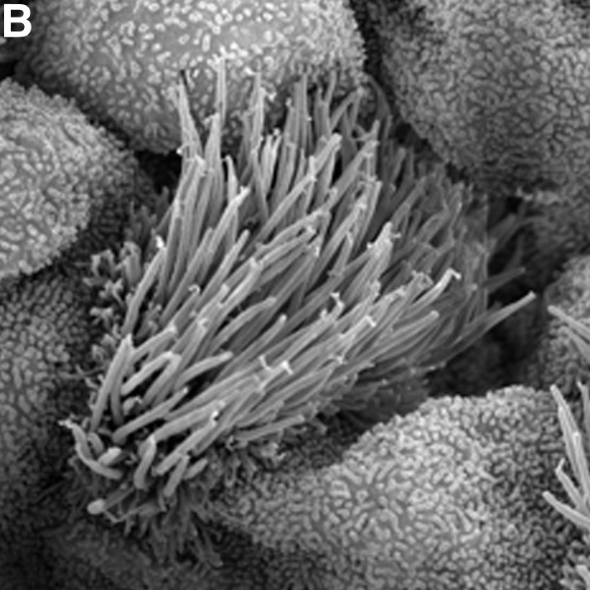
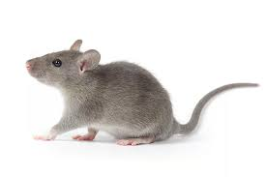
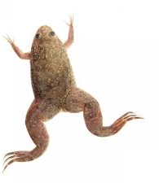
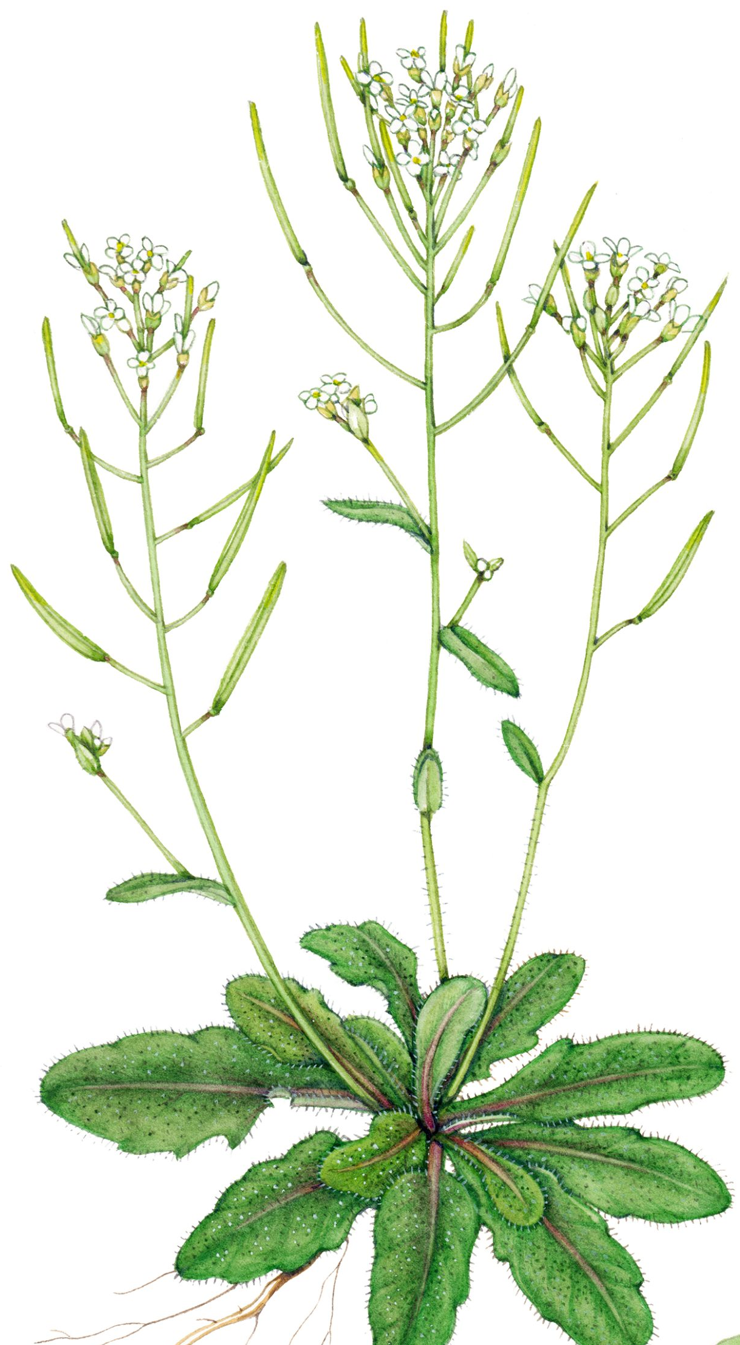
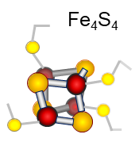
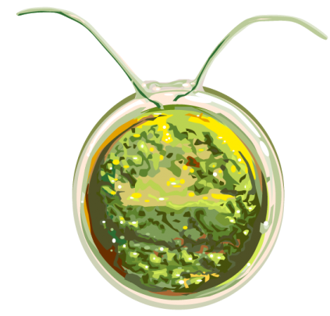
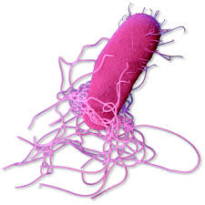
Personal background: InternshipS
Breast cancer
Mice
Cilia formation in multiciliated cells
Xenopus laevis
Photosynthesis adaptation
Arabidopsis thalina
Photosynthesis adaptation
Chlamydomonas reinhardtii
Iron-sulfure proteins
Salmonella enterica

Slide 3
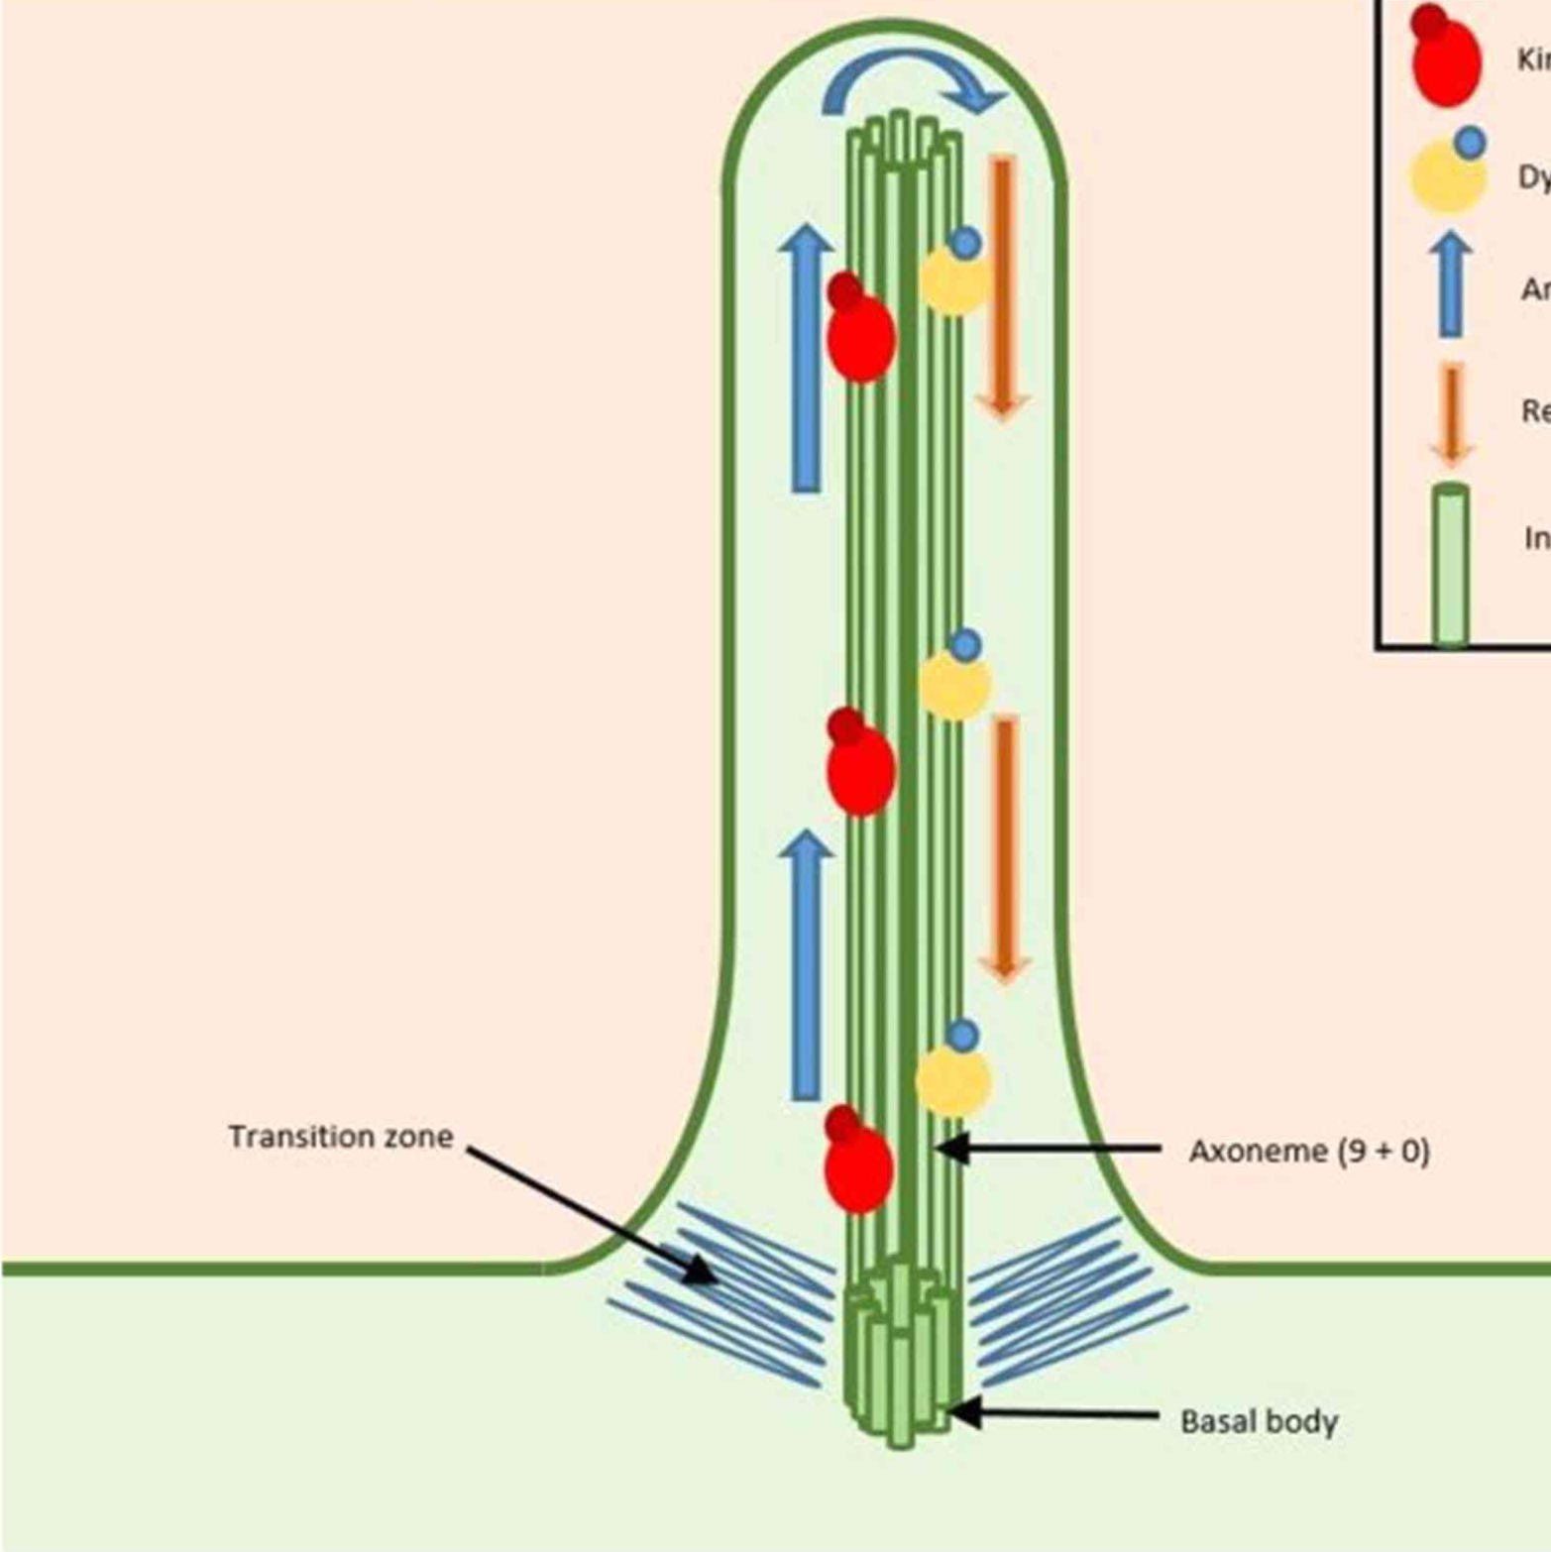
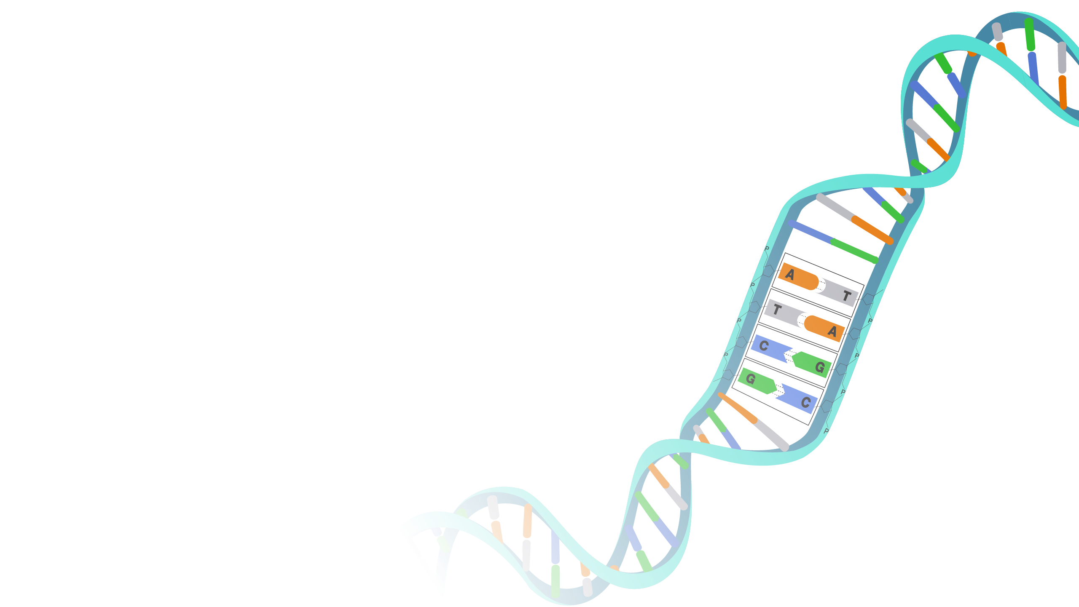
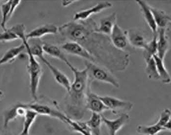
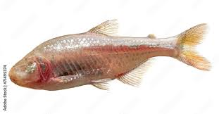
Personal background: InternshipS
Primary cilia composition
RPE-1 cells
Metabolic adaption of cavefish
Astyanax mexicanus

Slide 4
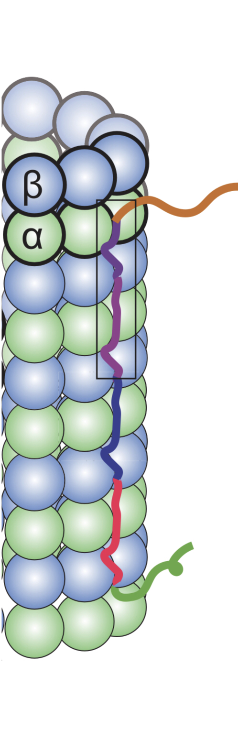
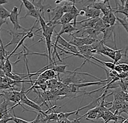
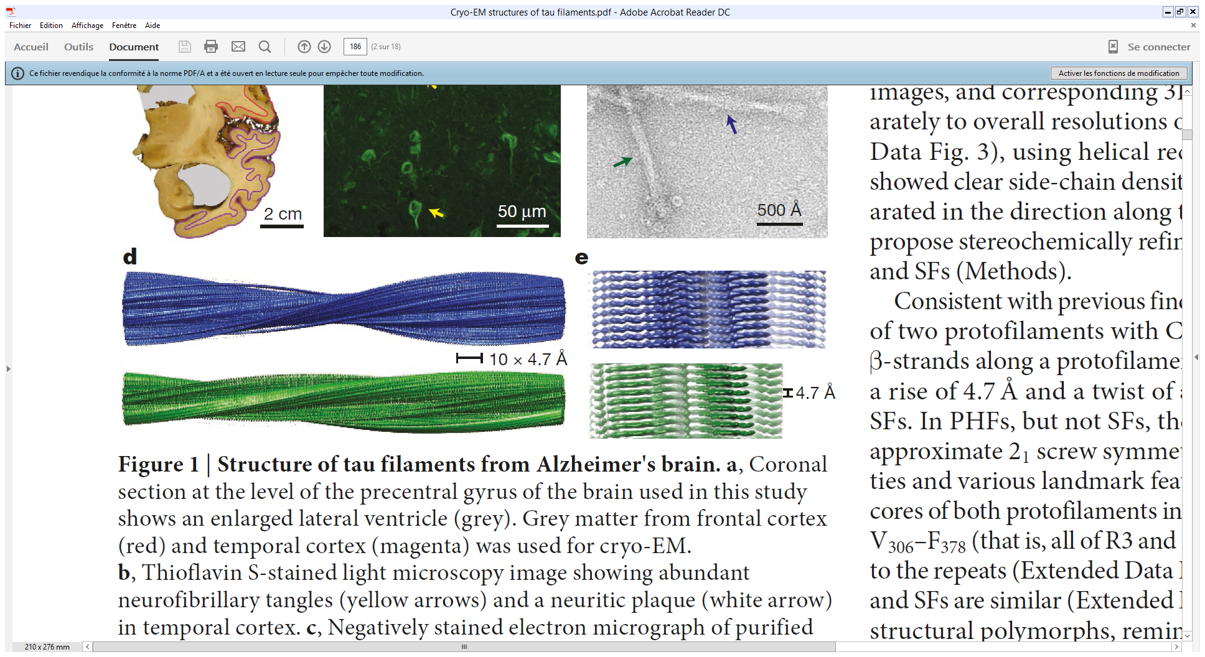
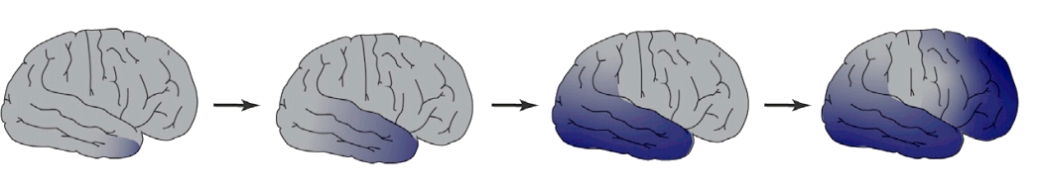
Personal background
Alzheimer’s disease and autophagy
SH-SY5Y cells

Slide 5
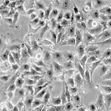
Personal background
2024
Autophagy initiation
HeLa cells

Slide 6

Personal background
2024
Parkinson’s disease and lipids
neuronal cells
Post-doctoral position EPFL
École Polytechnique Fédérale de Lausanne - Team D’ANGELO – Lausanne 🇨🇭
2025

Slide 7
Autophagy
endoplasmic
actin
lipid
reticulum
plasma membrane
droplet
stress
mitochondria
Catabolic process leading to the degradation of cytosolic components upon cellular stress
Autophagosome: double membrane vesicle
Golgi
lysosome
endolysosomes
MTOC
nucleus
autophagosome
auto
lysosome
auto
lysosome
autophagosome
phagophore
phagophore
peroxisome
omegasome
omegasome

Slide 8
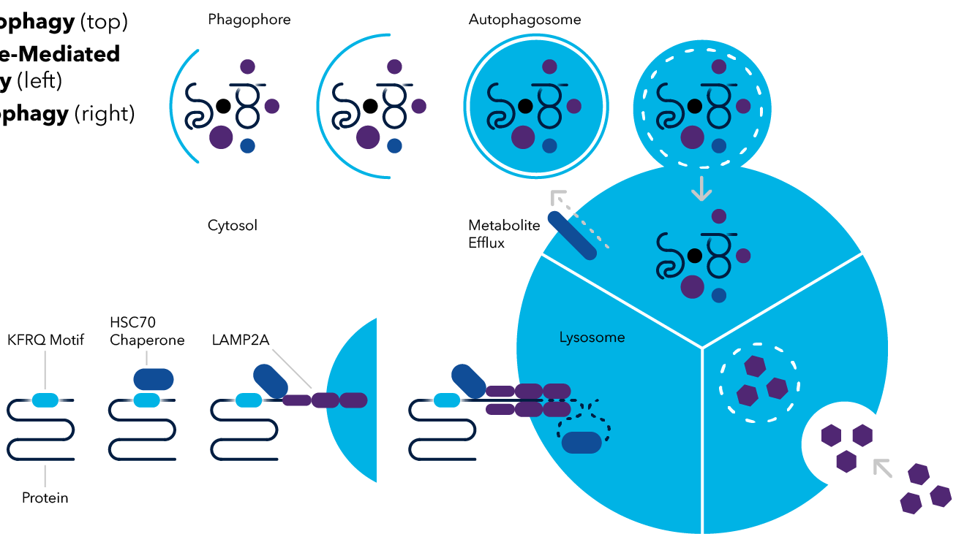
Types of autophagy
Macroautophagy
Lysosome
Chaperone-mediated autophagy
Microautophagy
Adaptated from bio-techne.com

Slide 9
(Macro) Autophagy initiation
lysosome
ATG8 family
autophagosome
LC3A
LC3B
LC3C
GABARAP
GABARAPL1
GABARAPL2
mTORC1
LC3
ATG4
AMPK
LC3
ATG8 system
ATG7
LC3
ATG3
ATG12 system
ATG12
phagophore
PI3KC3-C1
PI
ATG5
3
Ca²⁺
P
ATG9
ULK complex
AMBRA1
ATG16L1
ATG2
LC3
auto
lysosome
ATG101
FIP200
V
NRFB2
VPS34
WIPI2
omegasome
ATG13
A
VPS15
Beclin1
VMP1
ULK1
P
ATG14
VMP1
P
DFCP1
4
PI
3
PI
P
PI
PIS
phase separation
endoplasmic reticulum

Slide 10
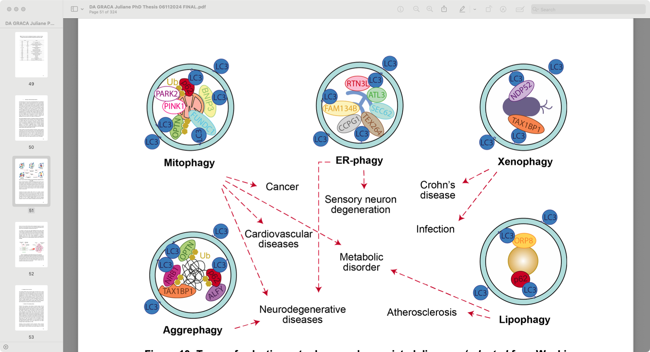
Selective autophagy
Mitochondria
Endoplasmic reticulum
Bacteria
LC3
Ubiquitin
cargo
LC3
receptor
signal
Proteins
Lipid droplets
LC3
Also DNA/RNA, peroxisome, lysosome, glycogen, ribosomes …

Slide 11
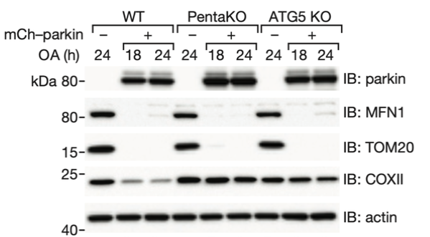
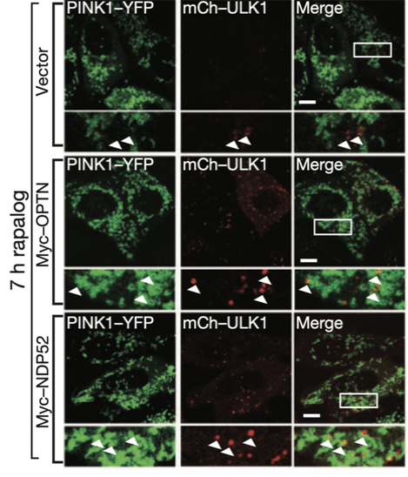
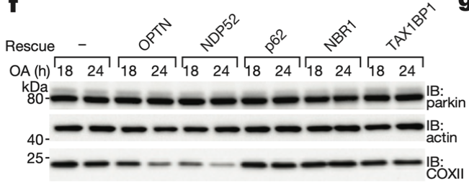
Mitophagy
Ubiquitination
LC3
PARKIN
PINK1
PINK1-PARKIN mediated autophagy
Ubiquitination of mitochondrial protein lead to their recognition by the autophagosome
What is the autophagic receptor ?
OA: Oligomycin/Antimycin → induce mitophagy
Ubiquitination induced by PINK1-PARKIN is recognized by OPTN and NDP52 to further recruit autophagy initiation complex
LC3
OPTN, NDP52
LC3
mitochondria
Lazarou et al., Nature (2015)

Slide 12
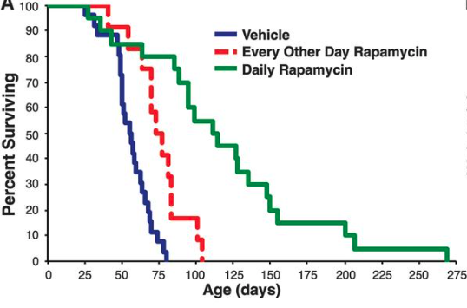
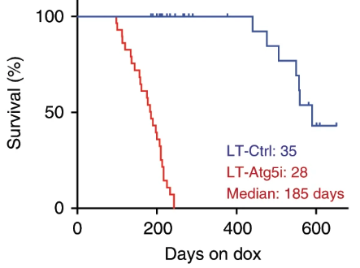
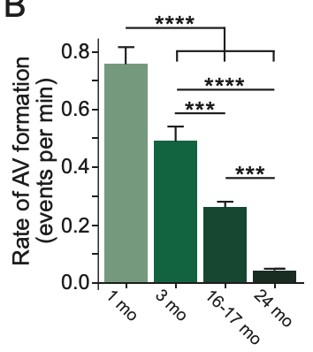
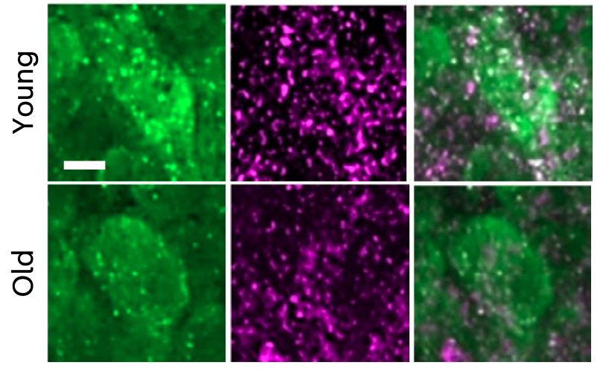
Autophagy and aging
Induction of autophagy (Rapamycin) increase lifespan
Inhibition of autophagy decrease lifespan
Autophagy is decreased in most tissues with age
Lysosomal activity is decreased with age
Mice
Johnson et al., Science (2013)
Cassidy et al., Nat Com (2020)
Lysosomal activity
Lysosome
merge
Rate of autophagosome formation (events per min)
Hippocampal neurons
Stavoe et al., eLife (2019)
Khawaja et al., Nature aging (2025)

Slide 13
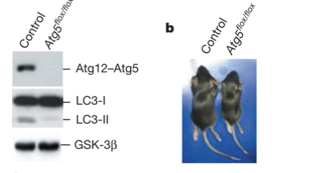
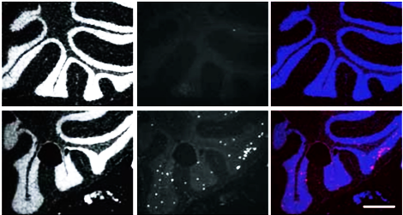
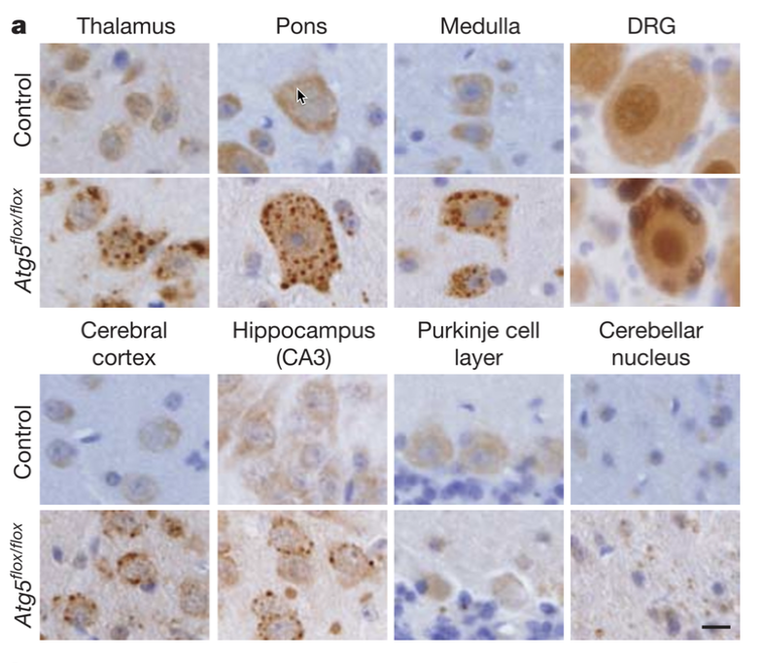
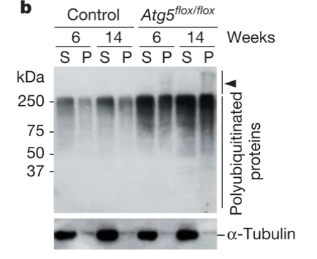
Autophagy and neurodegeneration
nucleus
Cell death
merge
Control
Mice lacking Atg5 in the nervous system (=autophagy deficient)
Autophagy protects from cell death
Autophagy deficient cells accumulate ubiquitinylated proteins
Autophagy is required for the basal and continous clearance of cytosolic proteins
Atg5^{flox/flox}
Hara et al., Nature (2006)

Slide 14

Neurodegenerative diseases and protein aggregation
Physiological form
Prion-like propagation of pathological aggregates throughout the brain
Aggregates leads to cellular death and alterations of brain-related functions
Risks increase with age
Why cells fail to degrade such protein aggregates?
aggregate
pathological confirmation
Alzheimer (AD)
Parkinson (PD)
Huntington
Tau
Amyloid-β
⍺-synuclein
Huntingtin

Slide 15
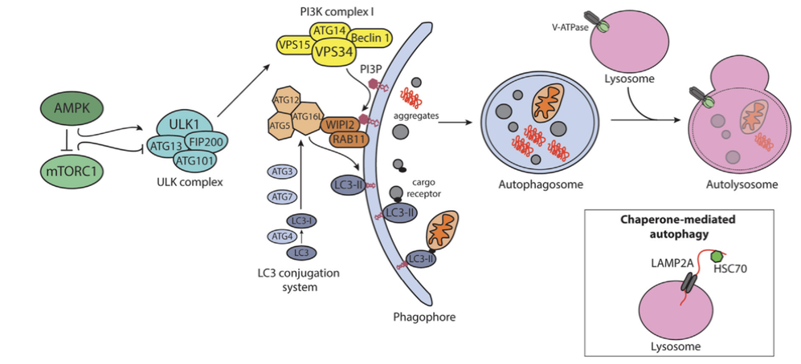
Autophagy
Palmer et al., Neuron (2025)

Slide 16
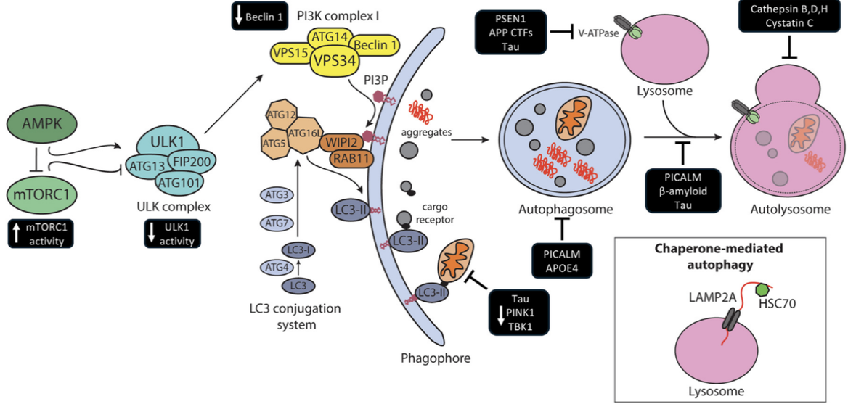
Autophagy during Alzheimer’s disease
Palmer et al., Neuron (2025)

Slide 17
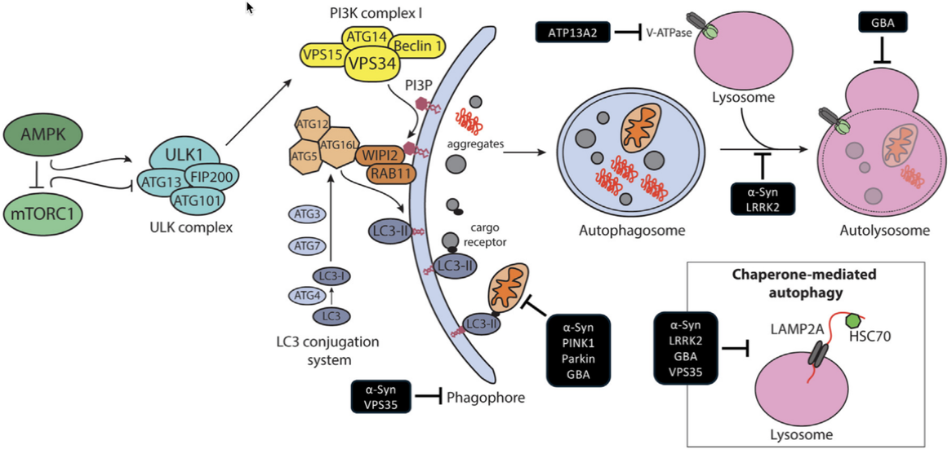
Autophagy during Parkinson’s disease
Palmer et al., Neuron (2025)

Slide 18
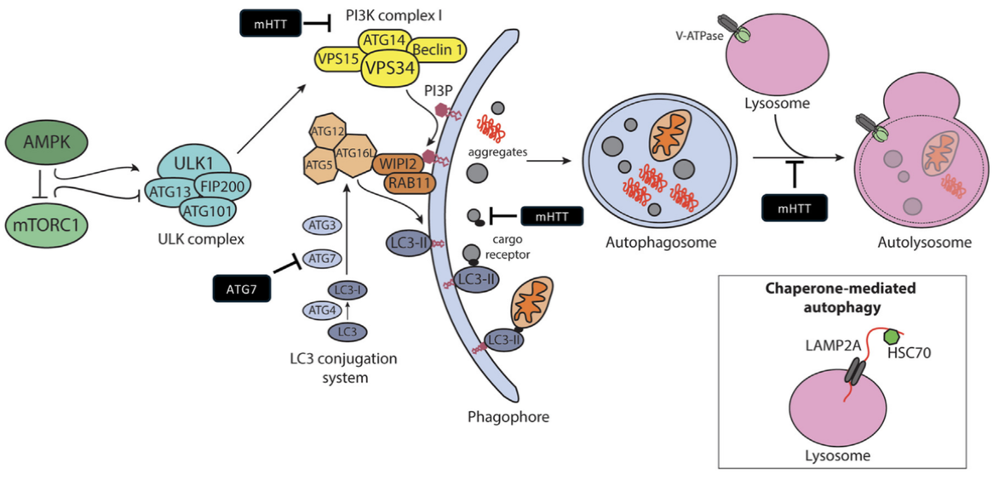
Autophagy during Huntington disease
Palmer et al., Neuron (2025)

Slide 19
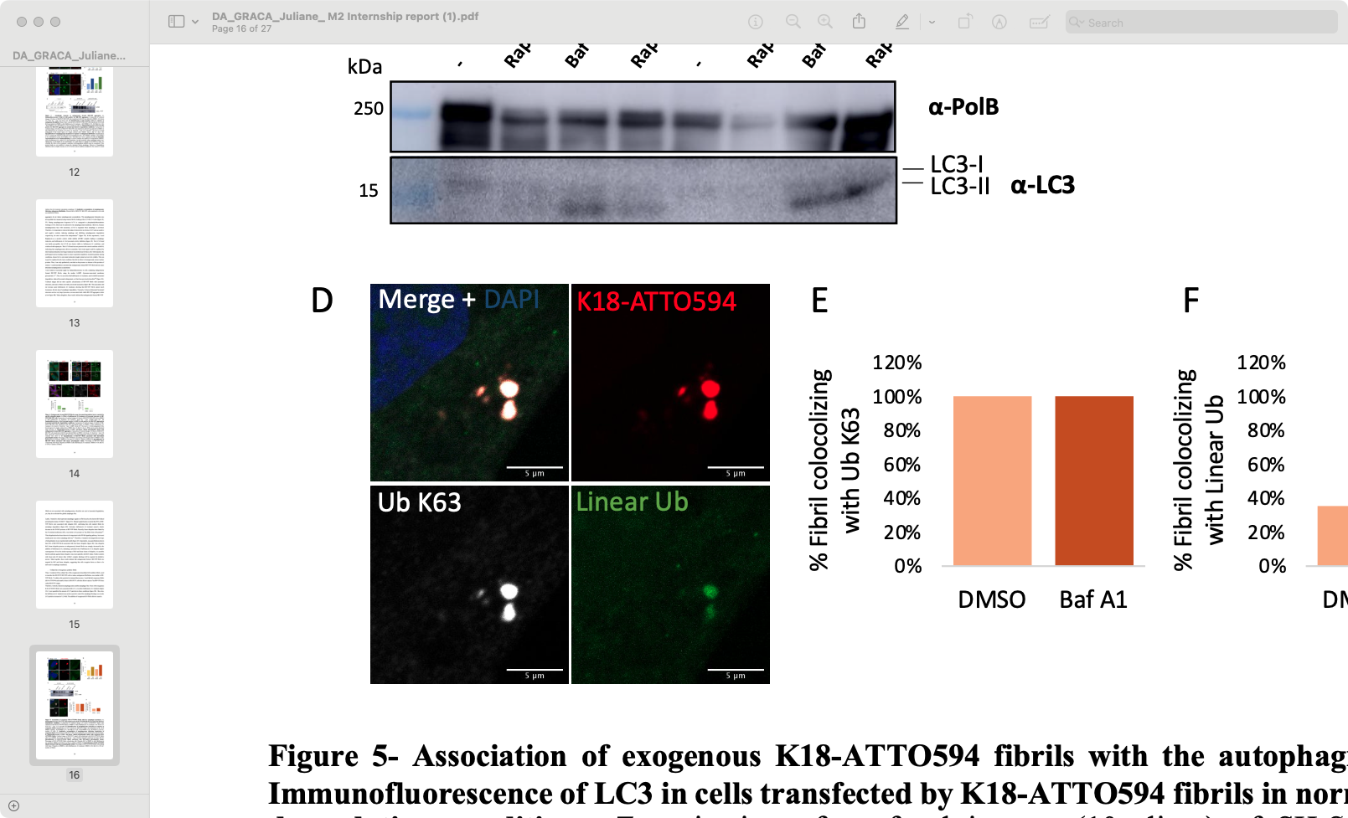
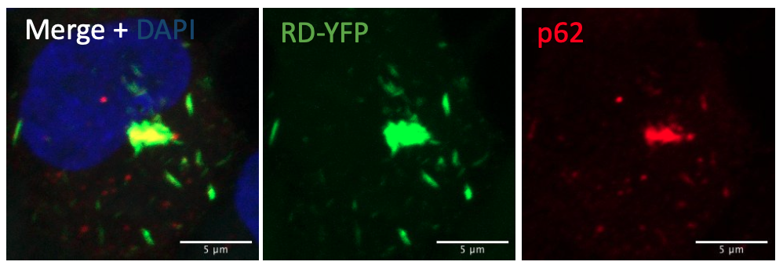
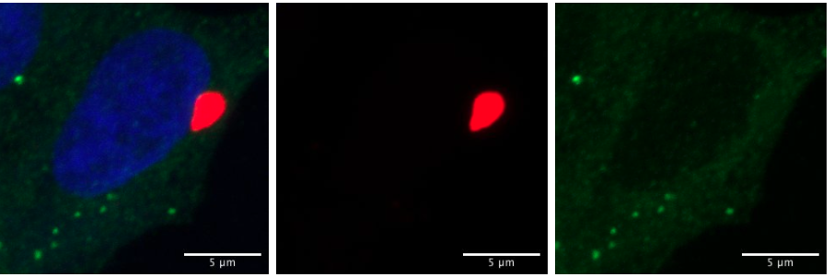
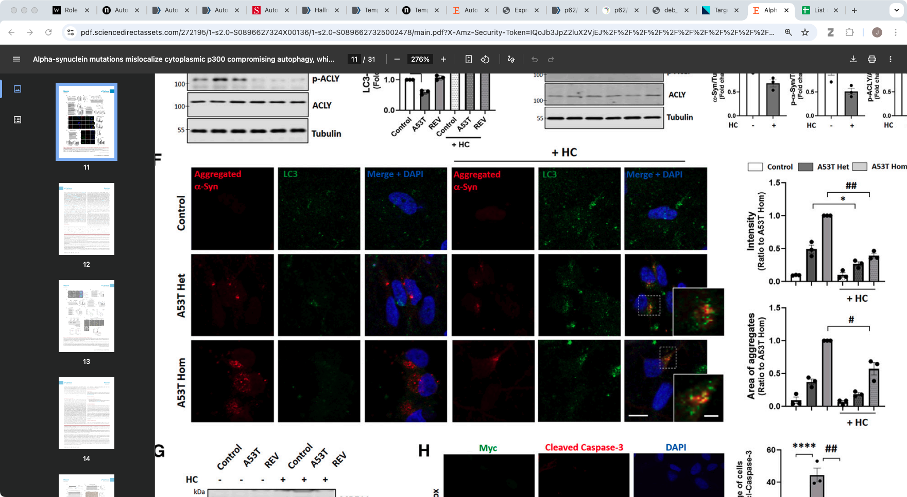
Targeting autophagy to treat neurodegenerative diseases?
Aggregated Tau
Ubiquitin
Aggregated Tau
Tau and ⍺-synuclein aggregates are ubiquitinated and p62+ but negative for LC3
Increase autophagic flux improve clearance of aggregates at early stages but can it work on large fibrils?
Too large to get engulfed?
receptor
Merge + DAPI
Aggregated Tau
LC3
LC3
receptor
LC3
LC3
Aggregated ⍺-syn
LC3
Merge+DAPI
Aggregated ⍺-syn
LC3
Merge+DAPI
Control
Autophagy induction
Son et al., Neuron (2025)

Slide 20
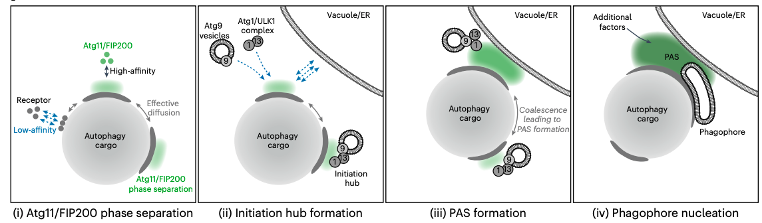
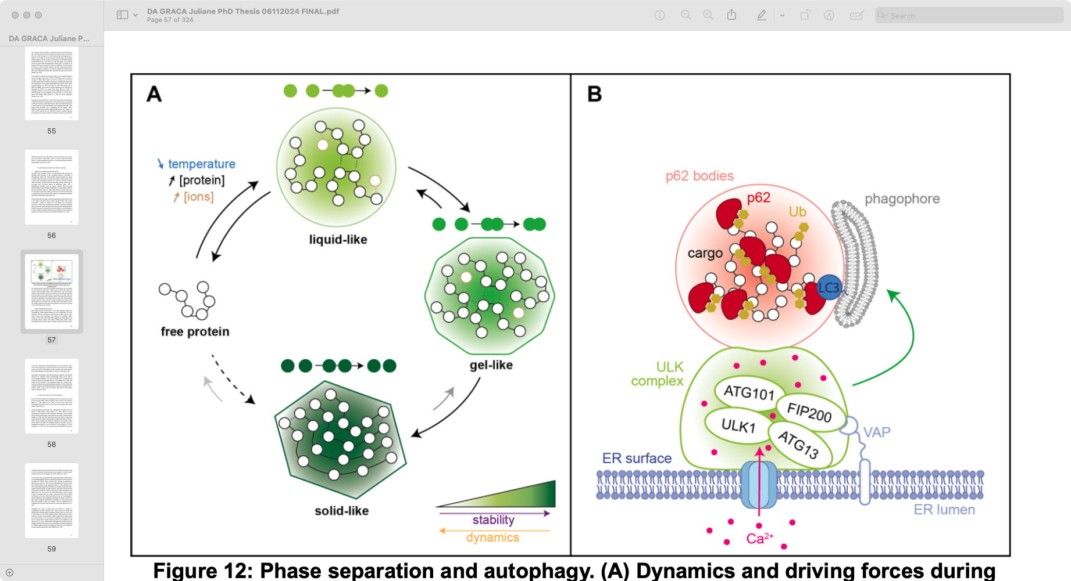
Importance of fluidity for autophagosome biogenesis
Liquid-like condensation is required for correct autophagosome biogenesis
Phase separation: physicochemical state stimulated by multivalent weak interactions or high concentration leading to condensation of macromolecules
In physiological conditions p62 and ubiquitin form liquid like condensates
Hyperstability of protein fibrils affect p62-Ub fluidity → inhibit correct autophagosome formation?
Licheva et al., Nature Cell biology (2025)

Slide 21
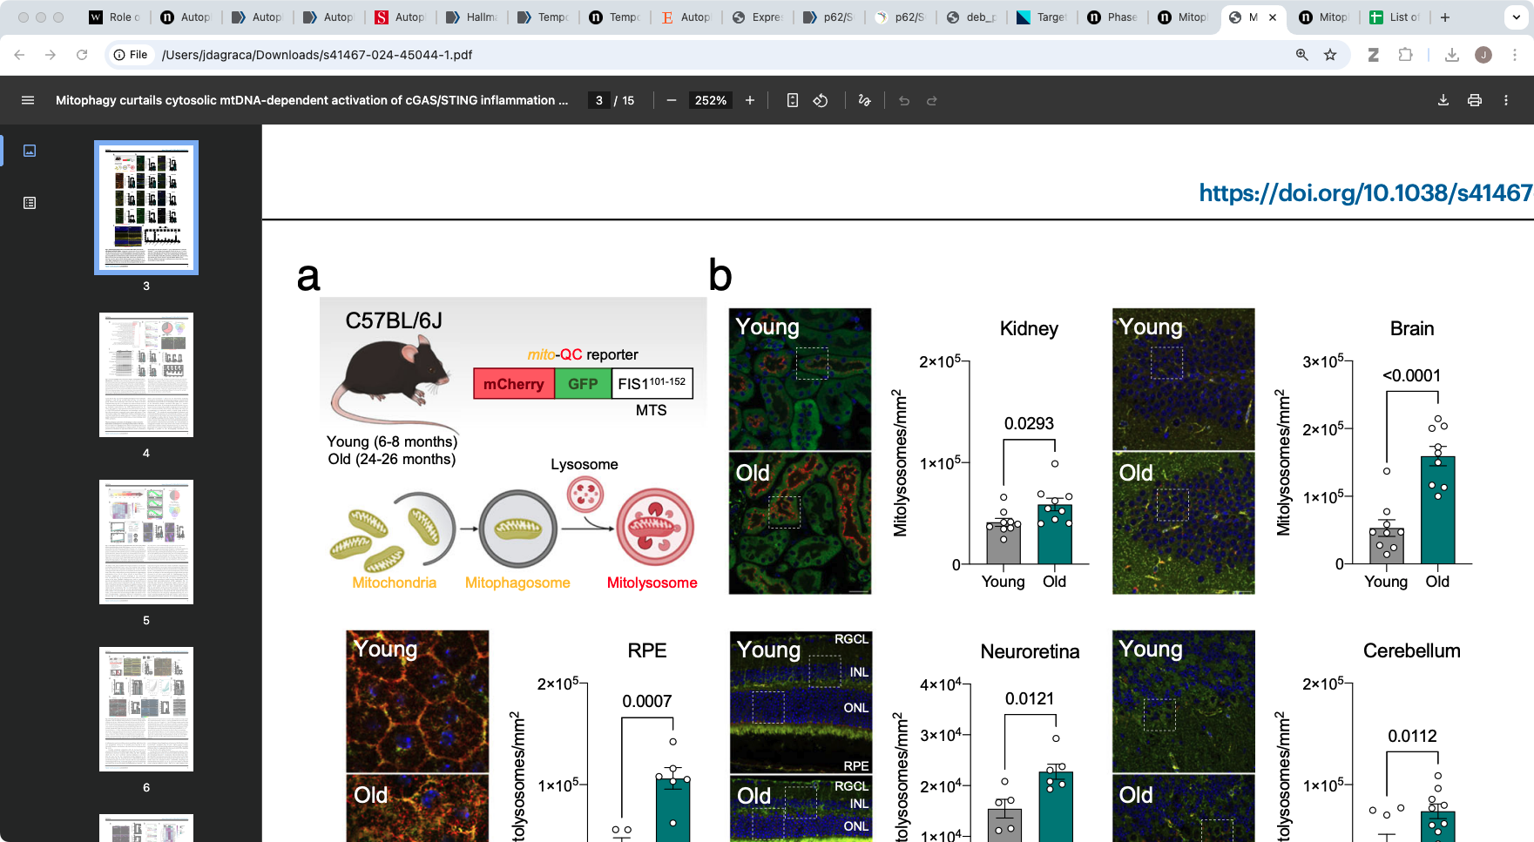
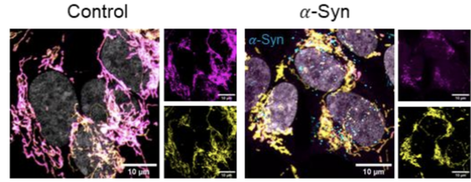
What needs to be degraded?
Mitophagy is increased in aging brain
⍺-Synuclein aggregates induce mitochondrial damage
In Parkinson’s disease mitophagy is dysfunctional thus damaged mitochondria accumulate
What needs to be degraded: aggregates, mitochondria or both?
Is mitophagy dysfunctional because aggregates hijack all Ub and p62?
Jimenez-Loygorri et al., Nat Com (2024)
Control
+ ⍺-Synuclein aggregates
Chakraborty et al., BioRxiv (2025)
Cytochrome c Mitochondria DAPI
Mitophagy
receptor
signal
receptor
signal
PINK1 PARKIN
receptor
signal
receptor
signal

Slide 22
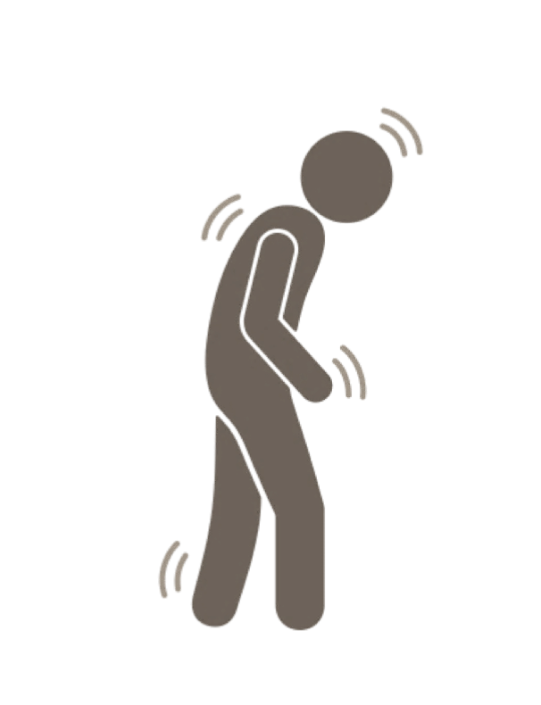

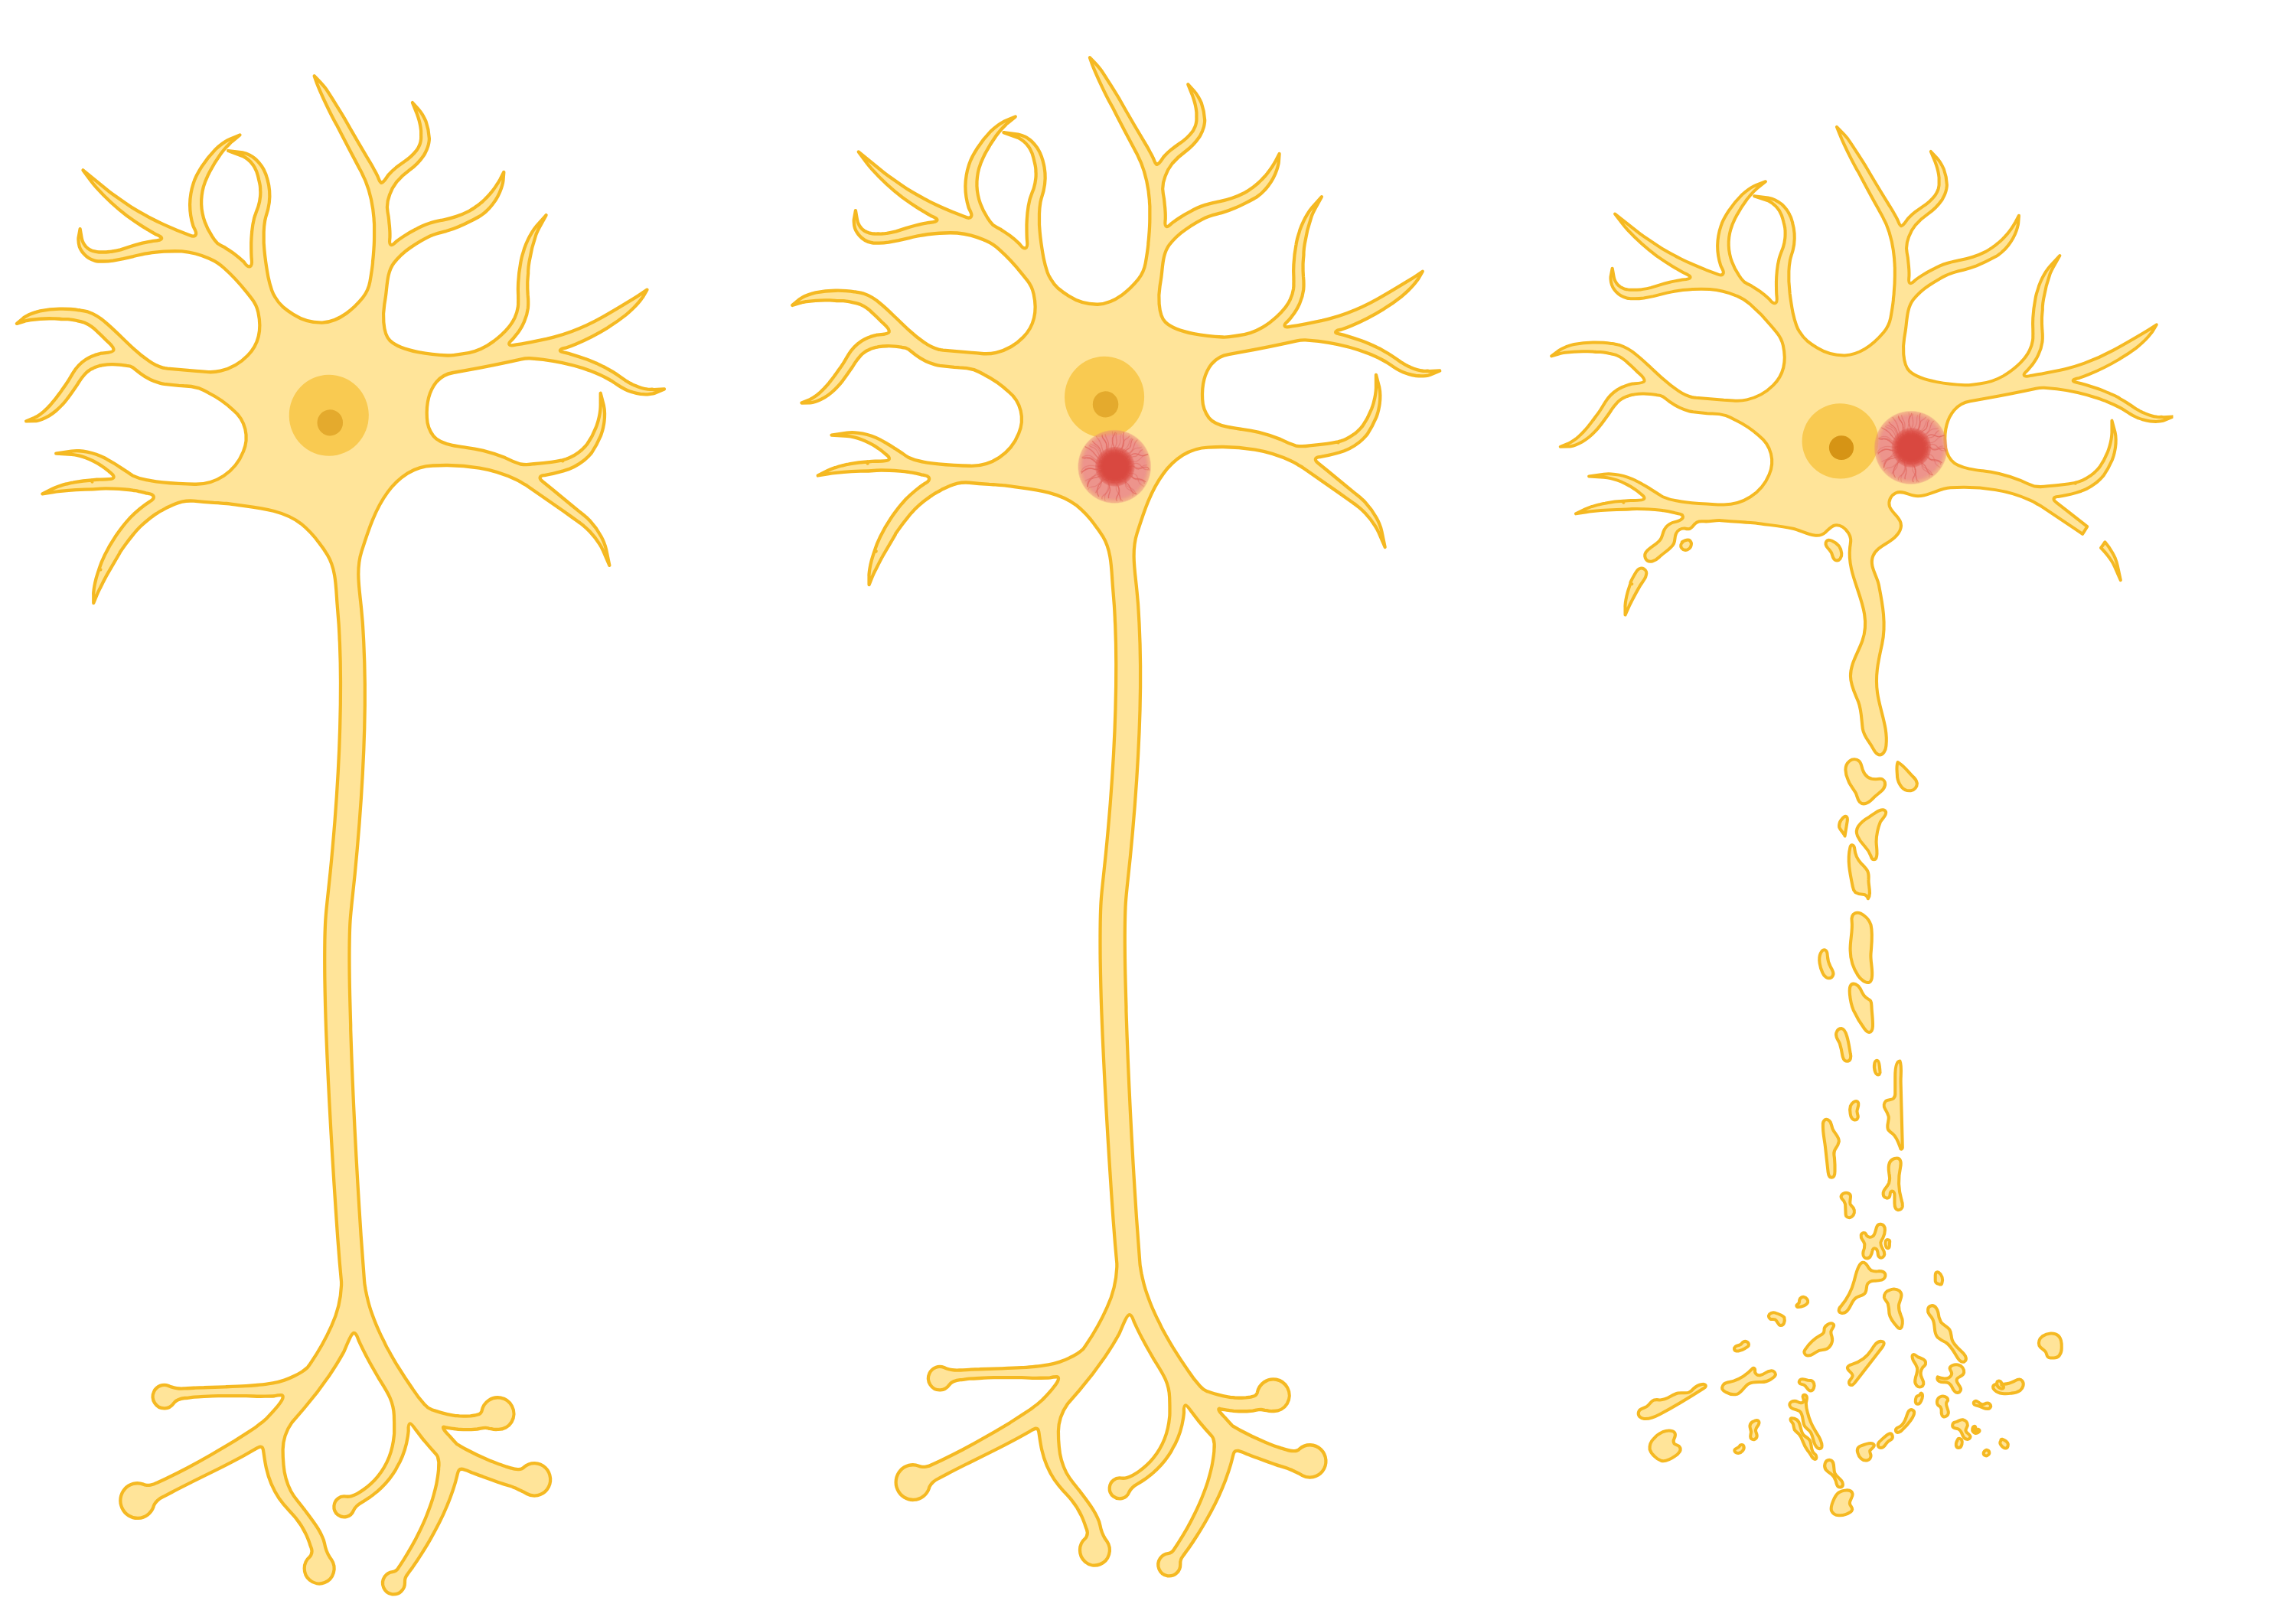
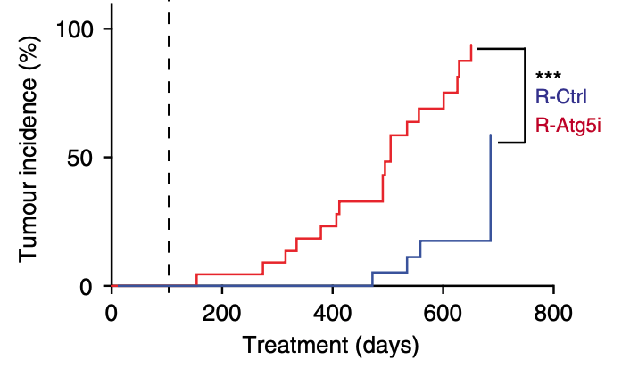
To treat or not to treat?
Diagnosis
~58 years
Is targeting autophagy to treat neurodegenerative disease really efficient?
Targeting autophagy might be efficient only during first steps of the disease but we lack biomarkers to act at this step
Global autophagy induction increase lifespan but also increase cancer formation
Shall we target specific steps in the autophagic pathway to treat neurodegeneration?
Or Shall we rather focus on other strategies?
?
?
-20
-10
0
10
20
~50% of targeted neurons dead
Years after diagnosis
Cassidy et al., Nat Com (2020)

Slide 23
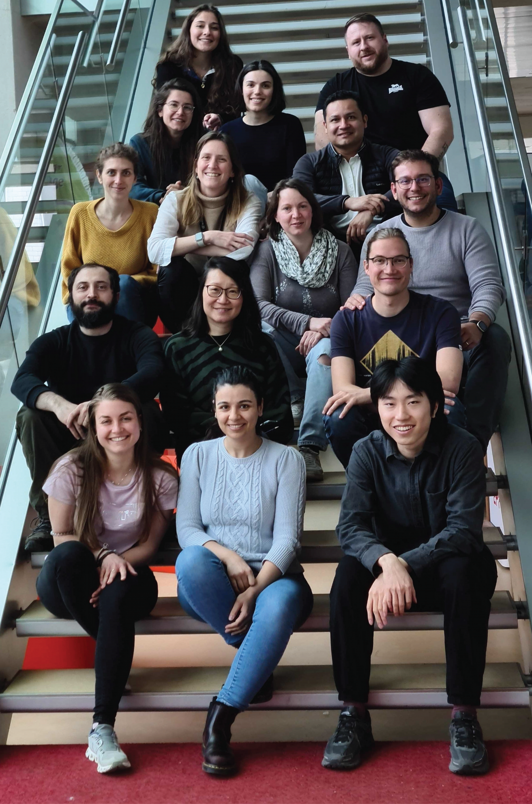
Acknowledgments
Giovanni D’Angelo
Anne-Laure Mahul Mellier
Sonia Marchegiano
Sylvia Ho
Yllza Jasiqi
Antonino Asaro
Agostina Crotta Asis
Juliane Da Graça
Pavel Barahtjan
Ilias Gkikas
Hannah Halima Schede
Surayyo Akramkhanova
Manel Boussouf
Nika Goršek
Irmak Kaysudu
Jiayan Lin
Jean Andrea Maillat
Thaïs Martin
Francesco Talotta
Fulvia Vitale
Christina Ulrich

